Slide 1
http://www.vidyanidhi.com/
ketkiacharya.net@gmail.com
Ketki Acharya
From: SM VITA ATC of CDAC
ketkiacharya.net@gmail.com

Slide 2
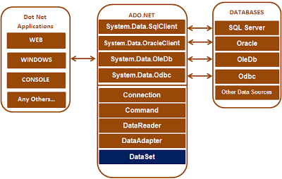

Slide 3
You can use the ADO.NET libraries in three conceptually unique manners:
connected,
disconnected, or
through the Entity Framework.

Slide 4
When you use the connected layer
your code base explicitly connects to and disconnects from the underlying data store.
When you use ADO.NET in this manner, you typically interact with the data store using
connection objects,
command objects, and
data reader objects.

Slide 5
Command
A command is, in its simplest form, a string of text containing SQL statements that is to be issued to the database.
A command could also be a stored procedure, or the name of a table that will return all columns and all rows from that table (in other words, a SELECT * - style clause).

Slide 6
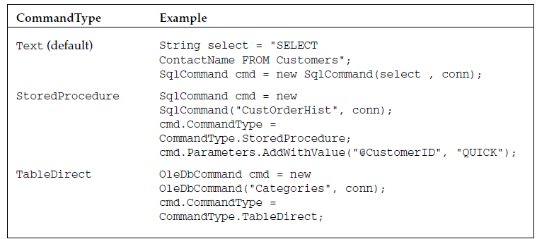
CommandType
The < provider > Command classes have a property called CommandType , which is used to define whether the command is a SQL clause, a call to a stored procedure, or a full table statement (which simply selects all columns and rows from a given table). CommandType enumeration.

Slide 8
If you are working with .Net core then
We are going to use NuGet to install the packages. Right-click on Project (“ConsoleApp”) and select "Manage NuGet Packages".
Click on the "Browse" tab and search for the following packages.
Install-package Microsoft.Extensions.Configuration;
Install-package Microsoft.Extensions.Configuration.FileExtensions;
Install-package Microsoft.Extensions.Configuration.Json;
Install-package System.Data.SqlClient;
Or type command
Install-packages name of dll file
Now, we need to add the appsettings file, where it contains our connection string to access the SQL Server Database.
Right-click on Project (“ConsoleApp”), go to Add, and click on "New Item".
Now, let’s add our connection string to the database in appsetings.json.
Observe no space
ConnectionStrings is one word
s
CamelCase
{ "ConnectionStrings": {
"Default": "Data Source=(localdb)\\ProjectModels;Initial Catalog=DemoData_Student;Integrated Security=True;"
}
}

Slide 9
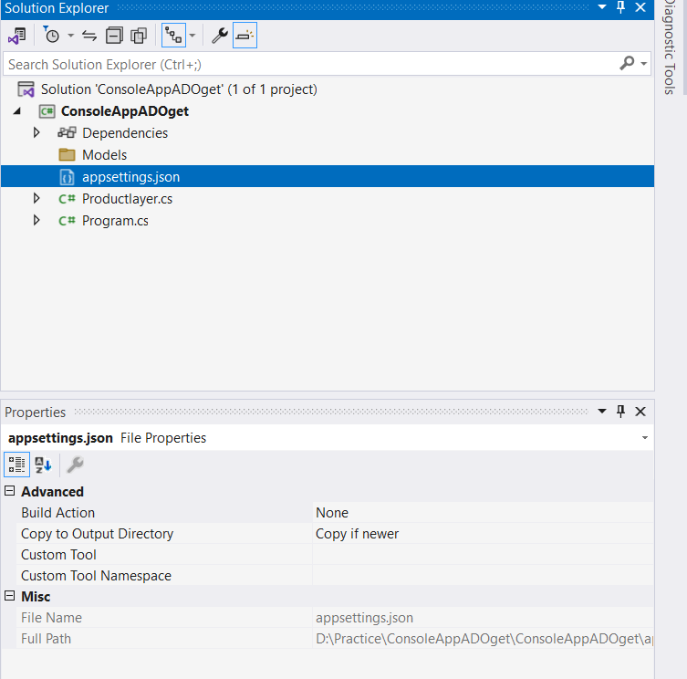
using System;
using ConsoleApp_ADO.DAL;
using Microsoft.Extensions.Configuration;
using System.IO;
namespace ConsoleApp_ADO
{
class Program
{
private static IConfiguration _iconfiguration;
static void Main(string[] args)
{
GetAppSettingsFile();
PrintProduct();
}
static void GetAppSettingsFile()
{
var builder = new ConfigurationBuilder()
.SetBasePath(Directory.GetCurrentDirectory())
.AddJsonFile("appsettings.json", optional: false, reloadOnChange: true);
_iconfiguration = builder.Build();
}
static void Printproduct()
{
Productlayer obj=new Productlayer(_ );
obj. Products()(); iconfiguration
}
}
}

Slide 10
Demo connected layer
using System;
using System.Data.SqlClient;
namespace ADO01_ConsoleApplication
{ public class Productlayer
{private string _connectionString;
public Productlayer(IConfiguration iconfiguration)
{
_connectionString = iconfiguration.GetConnectionString("Default");
}
public void Products()
{
using (SqlConnection con = new SqlConnection(_connectionString ))
{
// Pass the connection to the command object, so the command object knows on which
// connection to execute the command
SqlCommand cmd = new SqlCommand("Select * from Product", con);
// Open the connection. Otherwise you get a runtime error. An open connection is
// required to execute the command
con.Open();
Console.WriteLine("connected");
SqlDataReader rdr = cmd.ExecuteReader(); //returns object of sqldatareder
if (rdr.HasRows)
{
while (rdr.Read())
{
Console.WriteLine("{0} {1} {2} {3}", rdr["Id"], rdr["Name"], rdr["Price"], rdr["Qty"]);
}
}
}
}
}

Slide 11
SqlConnection con = new SqlConnection(connectionString)
ConnectionString=“”
Open()
con
CommandText=“Select * fromproduct ”
ExecuteReader();
return new SqlDataReader()
cmd
con
bool read()
id | name | price
rdr
SqlCommand cmd = new SqlCommand("Select * from Product", con);
SqlDataReader rdr = cmd.ExecuteReader();

Slide 12
namespace Microsoft.Extensions.Configuration
{
//
// Summary:
// Used to build key/value based configuration settings for use in an application.
public class ConfigurationBuilder : IConfigurationBuilder
{
public ConfigurationBuilder();
public IDictionary<string, object> Properties { get; }
.
public IConfigurationBuilder Add(IConfigurationSource source);
//
// Summary:
// Builds an Microsoft.Extensions.Configuration.IConfiguration with keys and values
// from the set of providers registered in Microsoft.Extensions.Configuration.ConfigurationBuilder.Sources.
//
// Returns:
// An Microsoft.Extensions.Configuration.IConfigurationRoot with keys and values
// from the registered providers.
public IConfigurationRoot Build();
}
IConfiguration
IConfigurationRoot
D:\DOT NET\c#new Feature\c#_7_new feature

Slide 13
public class ConfigurationBuilder : IConfigurationBuilder
return new ConfigurationRoot(list);
public class ConfigurationRoot : IConfigurationRoot, IDisposable
public interface IConfigurationRoot : IConfiguration
public static class FileConfigurationExtensions
{ public static IConfigurationBuilder SetBasePath(this IConfigurationBuilder builder, string basePath)
}
public static class JsonConfigurationExtensions{
public static IConfigurationBuilder AddJsonFile(this IConfigurationBuilder builder, string path, bool optional)
{ return builder.AddJsonFile(null, path, optional, reloadOnChange: false);
}}
public IConfigurationRoot Build()
{ var providers = new List<IConfigurationProvider>();
foreach (IConfigurationSource source in Sources)
{ IConfigurationProvider provider = source.Build(this);
providers.Add(provider);
}
return new ConfigurationRoot(providers);
}

Slide 14
The SetBasePath extension method is defined in Config.FileExtensions.
You need to add a reference to the Microsoft.Extensions.Configuration.FileExtensions package.
To resolve AddJsonFile, add a reference to the Microsoft.Extensions.Configuration.Json package.
ASP.NET Core supports many methods of configuration. In ASP.NET Core application, the configuration is stored in name-value pairs and it can be read at runtime from various parts of the application. The name-value pairs may be grouped into a multi-level hierarchy. The application configuration data may come from
File, such as JSON, XML, INI
Environment variables
Command Line arguments
An in-memory collection
Custom providers
Configuration System in ASP.NET Core is restructured from the older version of ASP.NET. The older version uses "System.Configuration" namespace and is able to read XML configuration files such as web.config.
The new configuration model can be accessed to the key/value-based settings and it can retrieve various sources, such as JSON, XML, and INI.

Slide 15
ConfigurationBuilder Class
ConfigurationBuilder Class
Definition
Namespace:
Microsoft.Extensions.Configuration
Assembly:
Microsoft.Extensions.Configuration.dll
Used to build key/value based configuration settings for use in an application.
public class ConfigurationBuilder : Microsoft.Extensions.Configuration.IConfigurationBuilder
Inheritance
Object
ConfigurationBuilder Implements IConfigurationBuilder

Slide 16
.SetBasePath(Directory.GetCurrentDirectory())
FileConfigurationExtensions.SetBasePath(IConfigurationBuilder, String) Method
Definition
Namespace:
Microsoft.Extensions.Configuration
Assembly:
Microsoft.Extensions.Configuration.FileExtensions.dll
Sets the FileProvider for file-based providers to a PhysicalFileProvider with the base path.
public static Microsoft.Extensions.Configuration.IConfigurationBuilder SetBasePath (this Microsoft.Extensions.Configuration.IConfigurationBuilder builder, string basePath);
basePath String
The absolute path of file-based providers.

Slide 17
AddJsonFile(IConfigurationBuilder, String, Boolean, Boolean)
Adds the JSON configuration provider at path to builder.
public static Microsoft.Extensions.Configuration.IConfigurationBuilder AddJsonFile (this Microsoft.Extensions.Configuration.IConfigurationBuilder builder, string path, bool optional, bool reloadOnChange);
Parameters
builder IConfigurationBuilder
The IConfigurationBuilder to add to.
Path String
Path relative to the base path stored in Properties of builder.
Optional Boolean
Whether the file is optional.
reloadOnChange Boolean
Whether the configuration should be reloaded if the file changes.

Slide 19
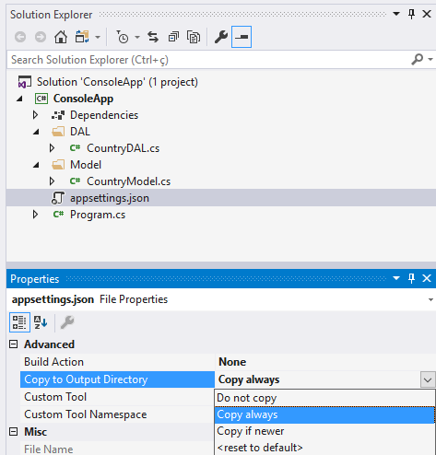
If you are working with .Net core then
This step is very important. We need copy appsetings.json to Directory where the application will run.
Step 5
Now, we will create 2 Folders ( “MODELS”“ and DAL”). After that, we will create a class named “ProductModel “ within Model folder and a class named “ProductDAL” within DAL folder.
ProductModel.cs represents our data model and ProductDAL.cs representes our data access layer.
TableName==Classname
Columnname==class Property

Slide 20
SSPI stands for Security Support Provider Interface.
The SSPI allows an application to use any of the available security packages on a system without changing the interface to use security services. The SSPI does not establish logon credentials because that is generally a privileged operation handled by the operating system.
Other than SSPI you can also use "true". Integrated Security actually ensures that you are connecting with SQL Server using Windows Authentication, not SQL Authentication; which requires username and password to be provided with the connecting string.

Slide 21
Intialised using construct or through set property
SqlConnection con = new SqlConnection(_connectionString );
SqlConnection connection = new SqlConnection();
connection.ConnectionString = _connectionString ;
In above line we are using setter property to set connection string.

Slide 22
Intialised using constructor through set property
SqlCommand cmd = new SqlCommand("Select * from Product", con);
SqlCommand cmd = new SqlComand();
cmd.CommandText = "select * from tblproduct";
//cmd.CommandType = CommandType.StoredProcedure;
cmd.Connection = con;

Slide 23
There are 2 issues with hard coding the connection strings in application code
1. For some reason, if we want to point our application to a different database server, we will have to change the application code. If you change application code, the application requires a re-build and a re-deployment which is a time waster.
2. All the pages that has the connection string hard coded needs to change. This adds to the maintenance overhead and is also error prone.
In real time, we may point our applications from time to time, from Development database to testing database .
Because of these issues, the best practice is to store the connection in the configuration file, from which all the pages can read and use it. This way we have only one place to change, and we don't have to re-build and re-deploy our application. This saves a lot of time.

Slide 24
< provider > Command classes provide the following execute methods:
ExecuteNonQuery() — Executes the command but does not return any output returns the number of rows affected by the command as an int eg:insert,update,delete
ExecuteReader() — Executes the command and returns a typed IDataReader This method executes the command and returns a typed data reader object, depending on the provider in use
eg:select
ExecuteScalar() — Executes the command and returns a single value. return a single result from a SQL statement, such as the count of records in a given table, or the current date/time on the server
eg:count,sum,etc Object
ExecuteXmlReader() — Executes the command and returns an XmlReader object, which can be used to traverse the XML fragment returned from the database

Slide 25
ExecuteScalar() is used when you are using aggrigate function➔return type is Object
using System;
using System.Configuration;
using System.Data.SqlClient;
namespace ADO_3_scallerConsoleApplication
{
public class Productcount
{
private string _connectionString;
public Productcount(IConfiguration iconfiguration)
{
_connectionString = iconfiguration.GetConnectionString("Default");
}
public int Product_cnt
{
get
{
int TotalRows = 0;
using (SqlConnection connection = new SqlConnection(_connectionString))
{
try
{
SqlCommand cmd = new SqlCommand("Select Count(Id) from Dept", connection);
connection.Open();
//As the T-SQL statement that we want to execute return a single value,
//use ExecuteScalar() method of the command object.
//Since the return type of ExecuteScalar() is object, we are type casting to int datatype
TotalRows = (int)cmd.ExecuteScalar();
}
catch (Exception ex)
{
// Handle Exceptions, if any
Console.WriteLine(ex.Message);
}
}
return TotalRows;
}
}
}

Slide 26
ExecuteNonQuery();[Insert, Update, Delete] return==>int
public class Productinsert
{
private string _connectionString;
public Productinsert(IConfiguration iconfiguration)
{
_connectionString = iconfiguration.GetConnectionString("Default");
}
public void product_insert()
{
using (SqlConnection connection = new SqlConnection(_connectionString ))
{
try
{
//Create an instance of SqlCommand class, specifying the T-SQL command
//that we want to execute, and the connection object.
SqlCommand cmd = new SqlCommand("insert into Product values (1, 'Iphone', 750000, 2)", connection);
connection.Open();
//Since we are performing an insert operation, use ExecuteNonQuery()
//method of the command object. ExecuteNonQuery() method returns an
//integer, which specifies the number of rows inserted
int rowsAffected = cmd.ExecuteNonQuery();
Console.WriteLine("Inserted Rows = " + rowsAffected );
//Set to CommandText to the update query. We are reusing the command object,
//instead of creating a new command object
cmd.CommandText = "update Product set Price= 15000 where Id = 2";
//use ExecuteNonQuery() method to execute the update statement on the database
rowsAffected = cmd.ExecuteNonQuery();
Console.WriteLine("Updated Rows = " + rowsAffected );
//Set to CommandText to the delete query. We are reusing the command object,
//instead of creating a new command object
cmd.CommandText = "Delete from Product where Id = 1002";
//use ExecuteNonQuery() method to delete the row from the database
rowsAffected = cmd.ExecuteNonQuery();
Console.WriteLine("Deleted Rows = " + rowsAffected );
}
catch (Exception ex)
{
// Handle Exceptions, if any
Console.WriteLine(ex.Message);
}
}
}
Id name price qty

Slide 28
SQL Injection
string s="D';delete from Product;Select * from Product where Name like ‘d”;
"Select * from Product where Name like '" + pname + “ %’ "
("Select * from Product where Name like '" +"D';delete from Product;Select * from Product where Name like ‘d” + "%’”
Select * from Product where Name like ‘” +”"D';delete from Product;Select * from Product where Name like ‘d” “+ "%’”
cmd.Parameters.AddWithValue("@ProductName", pname + "%");
String
Create Procedure spGetProductsByName
@ProductName nvarchar(50)
as
Begin
Select * from Employees
where Name like @ProductName + '%'
End

Slide 29
using ConsoleAppADONETSTUDENTS.Model;
using Microsoft.Extensions.Configuration;
using System;
using System.Data.SqlClient;
using System.Data;
namespace ConsoleAppADONETSTUDENTS.DAL
{
internal class EmpDAL
{
private string _connectionString;
public EmpDAL(IConfiguration iconfiguration)
{
_connectionString = iconfiguration.GetConnectionString("Default");
}
public void displayproduct(string pname)//"T"
{
using (SqlConnection connection = new SqlConnection(_connectionString))
{
try
{ //"v'; Delete from Product;Select * from Product where Name like 'v"
//Build the query dynamically, by concatenating the text, that the user has
//typed into the ProductNameTextBox. This is a bad way of constructing
//queries. This line of code will open doors for sql injection attack
// Select* from Product where Name like 'T%';
SqlCommand cmd = new SqlCommand("Select * from Employees where Name like '" + pname + "%'", connection);
connection.Open();
SqlDataReader rd = cmd.ExecuteReader();
while (rd.Read())
Console.WriteLine("{0} {1} {2}", rd["Id"], rd["Name"], rd["Salary"]);
}
catch (Exception ex)
{
Console.Write(ex.Message);
}
}
}
}
}

Slide 30
using ConsoleAppADONETSTUDENTS.DAL;
using Microsoft.Extensions.Configuration;
namespace ConsoleAppADONETSTUDENTS
{
internal class Program
{
private static IConfiguration _iconfiguration;
static void Main(string[] args)
{
GetAppSettingsFile();
PrintCountries();
}
static void GetAppSettingsFile()
{
var builder = new ConfigurationBuilder()
.SetBasePath(Directory.GetCurrentDirectory())
.AddJsonFile("appsettings.json", optional: false, reloadOnChange: true);
_iconfiguration = builder.Build();
var mypath = new ConfigurationBuilder().SetBasePath(Directory.GetCurrentDirectory());
Console.WriteLine(Directory.GetCurrentDirectory());
Console.WriteLine(new ConfigurationBuilder().SetBasePath(Directory.GetCurrentDirectory()));
}
static void PrintCountries()
{
// string s = "R";
string s = "R';delete from Employees;Select * from Employees where Name like 'R";
EmpDAL EmpDAL = new EmpDAL(_iconfiguration);
EmpDAL.displayproduct(s);
Console.WriteLine("Press any key to stop.");
Console.ReadKey();
}
}
}

Slide 31
Parameterized Query
using ConsoleAppADONETSTUDENTS.Model;
using Microsoft.Extensions.Configuration;
using System.Data.SqlClient;
namespace ConsoleAppADONETSTUDENTS.DAL
{
internal class EmpDAL
{
private string _connectionString;
public EmpDAL(IConfiguration iconfiguration)
{
_connectionString = iconfiguration.GetConnectionString("Default");
}
public void displayproduct(string pname)//"T"
{
using (SqlConnection connection = new SqlConnection(_connectionString))
{
try
{ //"v'; Delete from Product;Select * from Product where Name like 'v"
//Build the query dynamically, by concatenating the text, that the user has
//typed into the ProductNameTextBox. This is a bad way of constructing
//queries. This line of code will open doors for sql injection attack
// Select* from Product where Name like 'T%';
SqlCommand cmd = new SqlCommand("Select * from Employees where Name like @ProductName", connection);
cmd.Parameters.AddWithValue("@ProductName", pname + "%");
connection.Open();
SqlDataReader rd = cmd.ExecuteReader();
while (rd.Read())
Console.WriteLine("{0} {1} {2}", rd["Id"], rd["Name"], rd["Salary"]);
}
catch (Exception ex)
{ Console.Write(ex.Message);
}
}
}
}
}
printdata("\"vidya\""); //method call
//call without \” character
static void printdata(string s)
{
Console.WriteLine(s); //”vidya”
//vidya
}

Slide 32
using ConsoleAppADONETSTUDENTS.Model;
using Microsoft.Extensions.Configuration;
using System.Data.SqlClient;
using System.Data;
namespace ConsoleAppADONETSTUDENTS.DAL
{
internal class EmpDAL
{
private string _connectionString;
public EmpDAL(IConfiguration iconfiguration)
{
_connectionString = iconfiguration.GetConnectionString("Default");
}
public void displayproduct(string pname)//"T"
{
using (SqlConnection connection = new SqlConnection(_connectionString))
{
try
{ //"v'; Delete from Product;Select * from Product where Name like 'v"
//Build the query dynamically, by concatenating the text, that the user has
//typed into the ProductNameTextBox. This is a bad way of constructing
//queries. This line of code will open doors for sql injection attack
// Select* from Product where Name like 'T%';
SqlCommand cmd = new SqlCommand("spGetProductsByName", connection);
cmd.CommandType = CommandType.StoredProcedure;
cmd.Parameters.AddWithValue("@ProductName", pname + "%");
connection.Open();
SqlDataReader rd = cmd.ExecuteReader();
while (rd.Read())
Console.WriteLine("{0} {1} {2}", rd["Id"], rd["Name"], rd["Salary"]);
}
catch (Exception ex)
{
Console.Write(ex.Message);
}
}
}
}
}
StoreProcedure

Slide 33
Create Procedure spGetProductsByName
@ProductName nvarchar(Max)
as
Begin
Select * from Product
where Name like @ProductName + '%'
End

Slide 34
EmpDAL.cs
using System;
using System.Collections.Generic;
using ConsoleApp_ADO.Model;
using Microsoft.Extensions.Configuration;
using System.Data;
using System.Data.SqlClient;
namespace ConsoleApp_ADO.DAL
{
public class EmpDAL
{
private string _connectionString;
public EmpDAL(IConfiguration iconfiguration)
{
_connectionString = iconfiguration.GetConnectionString("Default");
}
public List<Employee> GetList()
{
var listEmployee = new List<Employee>();
try
{
using (SqlConnection con = new SqlConnection(_connectionString))
{
SqlCommand cmd = new SqlCommand("SP_emp_GET_LIST", con);
cmd.CommandType = CommandType.StoredProcedure;
con.Open();
SqlDataReader rdr = cmd.ExecuteReader();
while (rdr.Read())
{
listEmployee.Add(new Employee
{
id = Convert.ToInt32(rdr[0]),
name = rdr[1].ToString(),
salary = Convert.ToSingle(rdr[2])
});
}
}
}
catch (Exception ex)
{
throw ex;
}
return listEmployee;
}
}
}
Strongly type select
namespace ConsoleApp_ADO.Model
{
public class Employee
{
public int id { get; set; }
public string name { get; set; }
public double salary { get; set; }
}
}
Employee.cs
CREATE PROCEDURE [dbo].[SP_emp_GET_LIST]
AS
BEGIN
SELECT id
,name
,salary
FROM Employees
END

Slide 35
using System;
using ConsoleApp_ADO.DAL;
using Microsoft.Extensions.Configuration;
using System.IO;
namespace ConsoleApp_ADO
{
class Program
{
private static IConfiguration _iconfiguration;
static void Main(string[] args)
{
GetAppSettingsFile();
PrintCountries();
}
static void GetAppSettingsFile()
{
var builder = new ConfigurationBuilder()
.SetBasePath(Directory.GetCurrentDirectory())
.AddJsonFile("appsettings.json", optional: false, reloadOnChange: true);
_iconfiguration = builder.Build();
}
static void PrintCountries()
{
var EmpDAL = new EmpDAL(_iconfiguration);
var listCountryModel = EmpDAL.GetList();
listCountryModel.ForEach(item =>
{
Console.WriteLine(item.name);
});
Console.WriteLine("Press any key to stop.");
Console.ReadKey();
}
}
}

Slide 36
var EmpDAL = new EmpDAL(_iconfiguration);
"ConnectionStrings": {
"Default": "Data Source=(localdb)\\ProjectModels;Initial Catalog=StudentData;Integrated Security=True;"
},
_connectionString
EmpDAL
var listCountryModel = EmpDAL.GetList();
var listEmployee = new List<Employee>();
SqlConnection con = new SqlConnection(_connectionString)
_connectionString
.Open();
SqlCommand cmd = new SqlCommand("SP_emp_GET_LIST", con);
CREATE PROCEDURE [dbo].[SP_emp_GET_LIST]
AS
BEGIN
SELECT Id ,Name,Salary FROM Employees
END
"SP_emp_GET_LIST", con
SqlDataReader rdr = cmd.ExecuteReader();
New SqlDataReader()
cmd.CommandType = CommandType.StoredProcedure;
con.Open();
Read()
0 ID | 1 Name | 2 Salary
1 | Raj | 3000
2 | Mona | 75000
new Employee
{
}
Id = Convert.ToInt32(rdr["Id"]),
Name = rdr[1].ToString(),
Salary = Convert.ToSingle(rdr[2])

Slide 37
Strongly type select
public class Product
{
public int ID { get; set; }
public string Name { get; set; }
public float Price { get; set; }
public int Qty { get; set; }
}
public class Productlayer
{
private string _connectionString;
public Productlayer(IConfiguration iconfiguration)
{
_connectionString = iconfiguration.GetConnectionString("Default");
}
public List<Product> Products
{
get
{
;
List<Product> products = new List<Product>();
using (SqlConnection con = new SqlConnection(_connectionString ))
{
// Pass the connection to the command object, so the command object knows on which
// connection to execute the command
SqlCommand cmd = new SqlCommand("Select * from Product", con);
// Open the connection. Otherwise you get a runtime error. An open connection is
// required to execute the command
con.Open();
Console.WriteLine("connected");
SqlDataReader rdr = cmd.ExecuteReader(); //returns object of sqldatareder
while (rdr.Read())
{
Product pd = new Product();
pd.ID = Convert.ToInt32(rdr["Id"]);
pd.Name = rdr["Name"].ToString();
pd.Price = Convert.ToSingle(rdr["Price"]);
pd.Qty = Convert.ToInt32(rdr["Qty"]);
products.Add(pd);
}
return products;
}
}
}
}

Slide 38
Product p1 = new Product { Name = "LCD", Price = 90000, Qty = 5 };
class Employee
{
public int Id { get; set; }
public string Name { get; set; }
public float Salary { get; set; }
}
p1
Id
Name=LCD
Salary=90000
insertData indata = new insertData();
public SqlConnection getconnection()
class Program
{
static void Main(string[] args)
{
Employee p1 = new Employee {Id=5, Name = "LCD", Salary = 90000};
insertData indata = new insertData();
int a=indata.AddData(p1);
Console.WriteLine("{0}", a);
Console.WriteLine("----------------------------");
Product r = indata.search(1007);
Console.WriteLine("{0}{1}{2}", r.Id, r.Name, r.Price);
Console.WriteLine("----------------------------");
List<Product> pl= indata.search("TVvv");
if (pl != null)
{
foreach (var x in pl)
Console.WriteLine("{0}{1}{2}", x.Id, x.Name, x.Price);
}
else { Console.WriteLine("record with TVvv not found"); }
Console.WriteLine("----------------------------");
int no = indata.Del(2002);
Console.WriteLine("deleted {0}", no);
Console.ReadLine();
}
}
indata
public int AddData(Product e)
int a=indata.AddData(p1);
Console.WriteLine("{0}", a);

Slide 39
new SqlConnection();
using ConsoleAppADONETSTUDENTS.Model;
using Microsoft.Extensions.Configuration;
using System.Data.SqlClient;
using System.Data;
namespace ConsoleAppADONETSTUDENTS.DAL
{
internal class EmpDAL
{
private string _connectionString;
public EmpDAL(IConfiguration iconfiguration)
{
_connectionString = iconfiguration.GetConnectionString("Default");
}
public SqlConnection getconnection()
{
SqlConnection sqlconn = new SqlConnection();
sqlconn.ConnectionString = _connectionString;
return sqlconn;
}
public int AddData(Employee e)
{
SqlConnection sqlconn = null;
SqlCommand sqlcmd;
int record = 0;
try
{
sqlconn = getconnection();
sqlcmd = new SqlCommand("storedata", sqlconn);
sqlcmd.CommandType = CommandType.StoredProcedure;
sqlcmd.Parameters.Add("@Id", SqlDbType.Int).Value = e.Id;
sqlcmd.Parameters.Add("@pname", SqlDbType.NVarChar).Value = e.Name;
sqlcmd.Parameters.AddWithValue("@psalary", SqlDbType.Float).Value = e.Salary;
sqlconn.Open();
record = sqlcmd.ExecuteNonQuery();
}
catch (SqlException se)
{ Console.WriteLine(se.Message); }
finally
{
sqlconn.Close();
}
return record;
}
}
}
sqlconn
connstring
.Open();
sqlconn.ConnectionString = connstring;
sqlconn
sqlcmd
new SqlCommand("storedata", sqlconn);
sqlconn
CommandType
sqlconn = getconnection();
sqlcmd.ExecuteNonQuery();
SqlParametercollection
@Id
@pname
@psalary
@pname
@pprice
@Qty
Id
Name=LCD
Salary=90000
CREATE PROCEDURE storedata
CREATE PROCEDURE storedata
@id int,
@pname NVARCHAR(Max),
@psalary float
AS
BEGIN
INSERT INTO dbo.Employees( Id, Name ,Salary) VALUES ( @id, @pname , @psalary )
End

Slide 40
Search Overload Method[int ID]
public Product search(int id)
{
SqlConnection sqlconn = null;
SqlCommand sqlcmd;
Product p = null;
try
{
sqlconn = getconnection();
sqlconn.Open();
sqlcmd = new SqlCommand("select * from Product where id=@pid", sqlconn);
sqlcmd.Parameters.AddWithValue("@pid", id);
SqlDataReader rd = sqlcmd.ExecuteReader();
if (rd.HasRows)
{
while (rd.Read())
{
// int.TryParse("rd[Id"]", out r) ;
p = new Employee();
p.ID = Convert.ToInt32(rd["Id"]);
p.Name = rd["Name"].ToString();
p.Salary = Convert.ToSingle(rd[“Salary"]);
break;
}
}
}
catch (SqlException se)
{ Console.WriteLine(se.Message); }
finally
{
sqlconn.Close();
}
return p;
}
}
}

Slide 41
Search Overload Method[string name]
public List<Product> search(string name)
{
SqlConnection sqlconn = null;
SqlCommand sqlcmd;
List<Product> pl = null;
try
{
sqlconn = getconnection();
sqlconn.Open();
sqlcmd = new SqlCommand("select * from Product where name=@pid", sqlconn);
sqlcmd.Parameters.AddWithValue("@pid", name);
SqlDataReader rd = sqlcmd.ExecuteReader();
if (rd.HasRows)
{
pl = new List<Product>();
while (rd.Read())
{
p = new Employee();
p.ID = Convert.ToInt32(rd["Id"]);
p.Name = rd["Name"].ToString();
p.Salary = Convert.ToSingle(rd[“Salary"]);pl.Add(p);
}
}
}
catch (SqlException se)
{ Console.WriteLine(se.Message); }
finally
{
sqlconn.Close();
}
return pl;
}
From the list returning 1st record
Public Product search(string name)
{
Product one= pl.Select (data=>data).First();
return one;

Slide 42
public int Del(int id)
{
SqlConnection sqlconn = null;
SqlCommand sqlcmd;
int no = 0;
using (sqlconn = getconnection())
{
try
{
sqlconn.Open();
sqlcmd = new SqlCommand("delete from Employee where id=@pid", sqlconn);
sqlcmd.Parameters.AddWithValue("@pid", id);
no = sqlcmd.ExecuteNonQuery();
}
catch (SqlException se)
{ Console.WriteLine(se.Message); }
}
return no;
}

Slide 43
TASK
Create Table Employee with column name
Id Name Salary➔store data
Write DAL with Following Methods
Public Employee Search(int Id)
Public List<Employee> Search(String name)
Public int Deletedata(int Id)
Public int Updatedata(int id ,Employee e)

Slide 44
Fast Data Access: The Data Reader
it is also the least capable. You cannot directly instantiate a data reader object — an instance is returned from the appropriate database ’ s command object (such as SqlCommand ) after having called the ExecuteReader() method.
DataReader is a forward - only “ connected ” cursor. In other words, you can only traverse the records returned in one direction, and the database connection used is kept open until the data reader has been closed.

Slide 45
The disconnected layer
It allows you to manipulate a set of DataTable objects (contained within a DataSet) that functions as a client-side copy of the external data. When you obtain a DataSet using a related data adapter object, the connection is automatically opened and closed on your behalf.
As you would guess, this approach helps free up connections for other callers quickly and goes a long way toward increasing the scalability of your systems

Slide 46
Entity Framework
Using EF, you are able to interact with a relational database using client-side objects that encapsulate a number of low-level database specifics from view.
As well, the EF programming model allows you to interact with relational databases using strongly typed LINQ queries, using the grammar of LINQ to Entities.

Slide 47
ADO.NET ships with four database client namespaces:
SQL Server,
Oracle,
ODBC data sources,
any database exposed through OLE DB.
If your database of choice is not SQL Server or Oracle, use the OLE DB route unless you have no other choice than to use ODBC

Slide 48
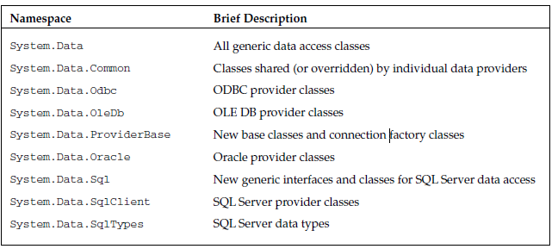
Namespaces

Slide 49
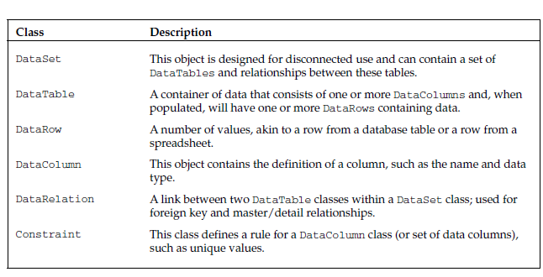
Shared Classes

Slide 50
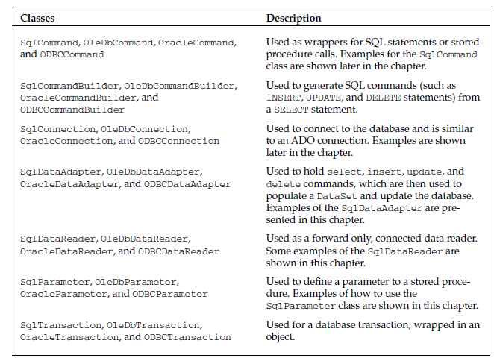

Slide 51
MarshalByRefObject
Component
DbConnection
DbCommand
OracleCommand
SqlCommand
OracleConnection
SqlConnection

Slide 52
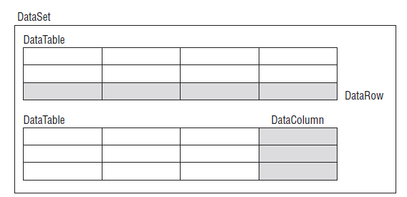
DataSet Class
A DataSet class consists of a set of data tables, each of which will have a set of data columns and data rows

Slide 53
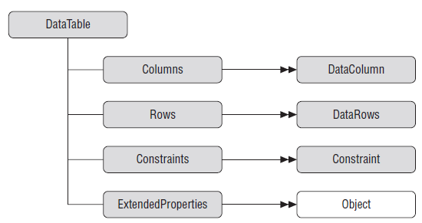
Data Tables

Slide 54
Disconnected Architecture
using ConsoleAppADONETSTUDENTS.Model;
using Microsoft.Extensions.Configuration;
using System.Data.SqlClient;
using System.Data;
namespace ConsoleAppADONETSTUDENTS.DAL
{
internal class EmpDAL
{ private string _connectionString;
public EmpDAL(IConfiguration iconfiguration)
{ _connectionString = iconfiguration.GetConnectionString("Default");
}
// Create an instance of DataSet, which is an in-memory datastore for storing tables
public void displayproduct()
{ // Create an instance of SqlDataAdapter. Spcify the command and the connection
SqlConnection connection = new SqlConnection(_connectionString);
SqlDataAdapter dataAdapter = new SqlDataAdapter("select * from Employees", connection);
// Create an instance of DataSet, which is an in-memory datastore for storing tables
DataSet dataset = new DataSet();
// Call the Fill() methods, which automatically opens the connection, executes the command
// and fills the dataset with data, and finally closes the connection. //no open method
dataAdapter.Fill(dataset);
Console.WriteLine(dataset.GetXml());
dataset.Tables[0].TableName = "Employees";
DataTable dt = dataset.Tables["Employees"];
// DataTable dt = dataset.Tables[0];
foreach (DataRow row in dt.Rows)
{ foreach (DataColumn col in dt.Columns)
Console.Write(row[col] + " ");
Console.WriteLine("----------------------------------");
}
}
}

Slide 55
SqlConnection connection = new SqlConnection(_connectionString)
connection
ConnectionString=“”
SqlDataAdapter dataAdapter = new SqlDataAdapter("select * from Product", connection);
dataAdapter
("select * from Product",
connection
Fill(dataset)
Tables[0]
id | name | price
dataset

Slide 56
Disconnected Architecture
using Microsoft.Extensions.Configuration;
using System.Data.SqlClient;
using System.Data;
namespace ConsoleAppADONETSTUDENTS.DAL
{
internal class EmpDALDisconnect
{
private string _connectionString;
SqlDataAdapter dataAdapter;
DataSet dataset;
SqlConnection connection;
public EmpDALDisconnect(IConfiguration iconfiguration)
{
_connectionString = iconfiguration.GetConnectionString("Default");
}
// Create an instance of DataSet, which is an in-memory datastore for storing tables
public void displayproduct()
{ // Create an instance of SqlDataAdapter. Spcify the command and the connection
// Call the Fill() methods, which automatically 0opens the connection, executes the command
// and fills the dataset with data, and finally closes the connection.
//no open method
connection = new SqlConnection(_connectionString);
dataAdapter = new SqlDataAdapter("select * from Employees", connection);
dataset = new DataSet();
// dataAdapter.SelectCommand.CommandText = "";
dataAdapter.FillSchema(dataset, SchemaType.Source, "Employees");
dataAdapter.Fill(dataset, "Employees");
DataTable dt = dataset.Tables["Employees"];
foreach (DataRow row in dt.Rows)
{
foreach (DataColumn col in dt.Columns)
Console.Write(row[col] + " ");
Console.WriteLine("----------------------------------");
}
}

Slide 57
SqlCommandBuilder
public void addindataset()
{
DataRow drCurrent = dataset.Tables["Employees"].NewRow();
drCurrent["Id"] = 8;
drCurrent["Name"] = "Ravina";
drCurrent["Salary"] = 90000;
dataset.Tables["Employees"].Rows.Add(drCurrent);
Console.WriteLine("Add was successful, Click any key to continue!!");
SqlCommandBuilder co = new SqlCommandBuilder(dataAdapter);
dataAdapter.Update(dataset, "Employees");
Console.WriteLine(co.GetInsertCommand().CommandText);
}
co
Update
dataset
emp
8 | Raveena | 90000
dataset.Tables["emp"].NewRow();
drCurrent
Id | Name | Salary
8 | Raveena | 9000
This class is responsible to write query.
Is this line require?
Yes

Slide 58
public void deletebyid(int id)
{
DataRow dd = dataset.Tables["Employees"].Rows.Find(id);
// dataset.Tables["emp"].Rows.;
dd.Delete();
SqlCommandBuilder co = new SqlCommandBuilder(dataAdapter);
dataAdapter.Update(dataset, "Employees");
// Console.WriteLine(co.GetDeleteCommand().CommandText);
}
public void updatedata(int id)
{
DataRow dd = dataset.Tables["Employees"].Rows.Find(id);
dd["Name"] = "Vidya";
SqlCommandBuilder co = new SqlCommandBuilder(dataAdapter);
dataAdapter.Update(dataset, "Employees");
// Console.WriteLine(co.GetUpdateCommand().CommandText);
}
public void displayxml()
{
Console.WriteLine(dataset.GetXml());
}

Slide 59
Q1.create table user with id name password.
Create poco class user with column Id, name,Password
Store id name password in database.
When you load application print message welcome to crimson
Enter:
Name:
Password:
Validate the user ie check if user name is there in table or not if yes display employee details.
For this you need to have employee table having detail id name salary gender.
Create poco class Employee with id name salary gender.
Use connected architecture
Use store procedure.

Slide 60
A transaction allows you to execute two or more SQL commands in such a way that if any one of the statements fail, then no other statement will change the database. Either all operations in the transaction are performed, or none.
Now let us consider a situation. First the customer is going to transfer $10 from your account to a second customer account. Now how it can be done? There are two steps that can be involved in it.
The first customer will deduct $10 from the account
The second customer will add $100 to the account
Now think, after completion of step1, something bad happens or some error happens for which step 2 didn't complete. What will occur? $10 will be deduced from the first customer's account but it will not be added to the second customer account. $10 will be missing. Transactions help to avoid these types of problems by ensuring that if any one of the statements fail, then no other statement will be able to change. If step 2 fails, then the changes made by step 1 will not be committed to the database.
ACID properties
A transaction is a way to group SQL statements together so that, when executed, the transaction obeys the ACID principles. In a perfect transaction world, a transaction must contain a series of properties known as ACID. These properties are:
Atomicity
The Atomicity property of the transaction defines that a transaction is an atomic unit of work or collection of separate operations. In electronic transactions, the transaction needs to be done either by 100% or 0%. This property ensures that the transaction is successful and if by chance the transaction can not be done fully, it brings the system in previous state or rollback.
Consistency
A transaction must leave the database into a consistent state whether or not it is completed successfully. The data modified by the transaction must comply with all the constraints in order to maintain integrity.
Isolation
One transaction does not interfere with another running at the same time. In case of only one transaction, it does not matter.
Durability
A committed transaction will not be lost. If the system fails later on, the data can be retrieved.

Slide 61
Creating Transactions
Call the BeginTransaction method of the Connection object to mark the start of the transaction. The BeginTransaction method returns a reference to the Transaction. This reference is assigned to the Command objects that are enlisted in the transaction.
BeginTransaction() - To Begin a database transaction
You may use the following methods to work with the transaction.
Commit Transaction - This ensures the successful end of a transaction. It passes signals to the database to save the work.
Rollback Transaction - This denotes that a transaction has not been successful and passes signals to the database to roll back to the state it was in before starting of the transaction.

Slide 62
using System;
using System.Collections.Generic;
using System.Configuration;
using System.Data.SqlClient;
public class TSqlDemo
{
public void TsqlMethod()
{
;
SqlConnection sqlConnection = new SqlConnection(_connectionString);
sqlConnection.Open();
SqlTransaction sqlTransaction = sqlConnection.BeginTransaction();
SqlCommand sqlCommand = new SqlCommand();
sqlCommand.Transaction = sqlTransaction;
try
{
sqlCommand.CommandText = "Insert into Product (Name,Price,Qty) VALUES ('Joydip',5000,50)";
sqlCommand.ExecuteNonQuery();
//make some error
sqlCommand.CommandText = "Insert into Product (Name,Price,Qty) VALUES ('Software',40000, 1)";
sqlCommand.ExecuteNonQuery();
sqlTransaction.Commit();
//Usual code
//
}
catch (Exception e)
{
sqlTransaction.Rollback(); //Usual
}
finally
{
sqlConnection.Close();
}
}
}

Slide 63
SQL Server start?
Services
Window key type services
Start[MSSQL]

Slide 64
Q/A
Which class is responsible to load Appsetings.Json file and read key
[ConfigurationBuilder]
Which class is responsible to initialized connection string
Which class is responsible to initialized sql query string
CommandType=
Which class is responsible to open connection
Which class is responsible to fire the query
What is the return type of execute reader methods
Which method indicate about data in memory
Read method is in which class

